Slide 1
What is Visual Question Answering ?
VQA answers open ended natural language questions about an image
Image
VQA Model
Answer
Question related to the image

Slide 2
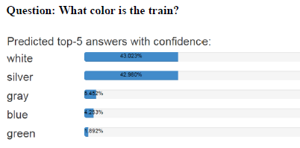
What is Visual Question Answering ?
Goal is to predict the answer of a given question related to an image, proposed method formulates it as a multi class classification problem.
Image
VQA Classification Model
Question:
What color is the train?
Predicted answer (classes)
Example generated using CloudCV, http://vqa.cloudcv.org/

Slide 3
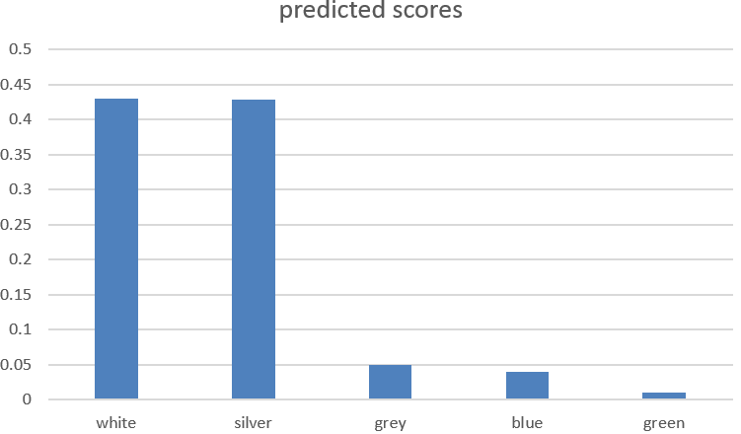
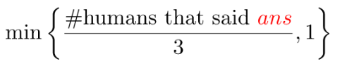
VQA as a classification problem
Proposed model approaches VQA as a multi label classification over a set of candidate answers.
Candidate answers are those answers that appear more than 8 times in training set, 3129 such answers have been taken as a possible candidate class.
Figure: Image
Figure: predicted scores, only classes with non zero scores shown
Question: What color is the train?
Human annotations (Ground truth): {white, white ,silver , grey, silver ,silver , white, white, white, grey}
Soft scores (Class labels): {white: 1, silver 1} , soft score is
Soft scores as targets allows multiple correct answers per question, which is often the case due to uncertainty in ground truth annotations.
Prediction : top two predicted classes, White (0.43), Silver (0.429)

Slide 4
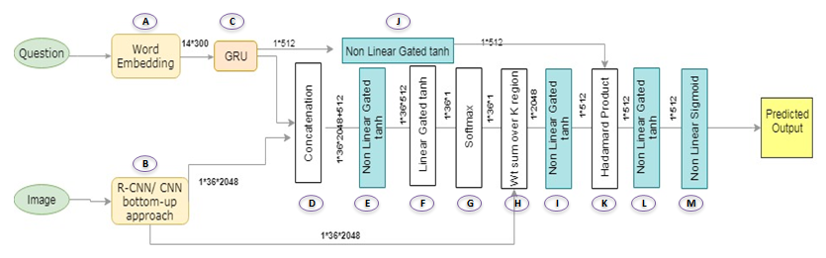
VQA bottom up – top down attention model
Proposed model implements a multi class classification model, with joint embedding of Image and Question, and bottom up and top down image attention, which was further improved using dual stacked attention.
Figure: Proposed model overview, a deep neural network classification model, based on joint embedding of image and question
Next, we look at each step in more detail …..
Model architecture inspired from “Bottom-Up and Top-Down Attention for Image Captioning and Visual Question Answering” Peter Anderson, Xiaodong He ,Chris Buehler

Slide 5
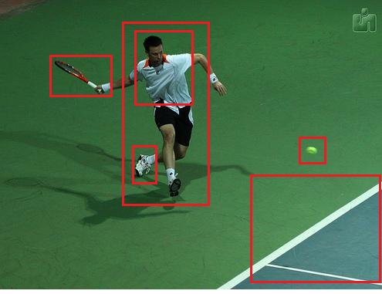
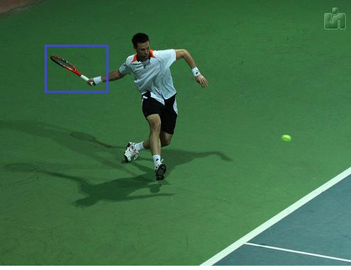
bottom up – top down attention model
Question: what is the man holding in hand?
Bottom up attention
Provides salient image regions, each region represented by a CNN pooling layer feature vector of Faster R-CNN
Top down attention
Task specific , in this example, question is related to man holding an object, thus the corresponding image region is given more importance.

Slide 6
Question embedding
GRU
(Internal state dim. 500)
Time step 1
Question:
What color is the train?
Glove word embedding
(300 dimension)
Tokenize and text preprocessing
Time step 2
Time step 3
Question tokenized vector (1 X 14)
(1 X 14 X 300)
Time step n
Text preprocessing
Convert to lowercase
Convert number words to digits
Removing articles (a, an, the)
Fix contractions (e.g., convert "don't" to "don't")
Replace punctuation characters (except apostrophe and colon) with a space.
Tokenize and take first 14 words, only 0.25 % questions have more than 14 words.
For each question, calculate soft scores of candidate answer classes. This is the ground truth label
Question encoding (1 X 512)

Slide 7
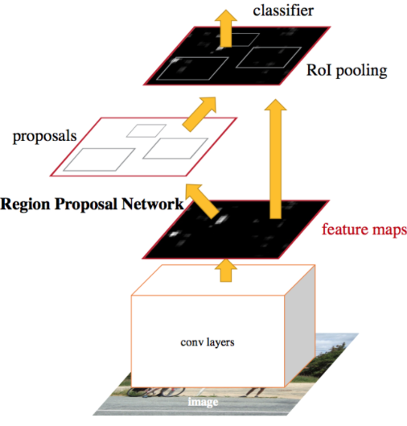
Image features, Bottom up attention
Object centric image feature map
* We used publicly available VQA 2 image features, from a Faster RCNN trained on Visual Genome dataset
Bottom up image attention features (1 X 36 X 2048)

Slide 8
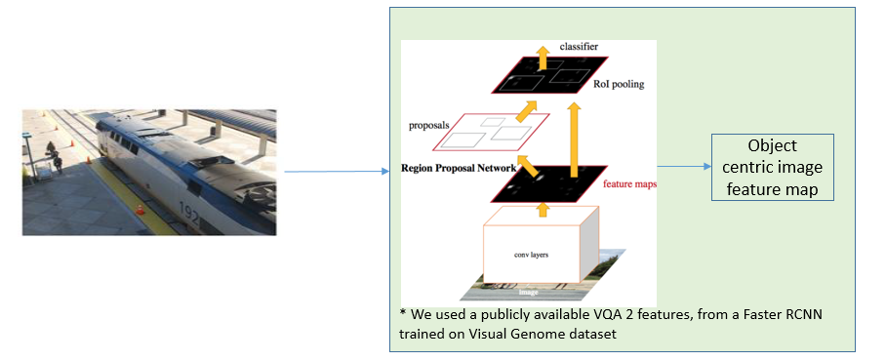
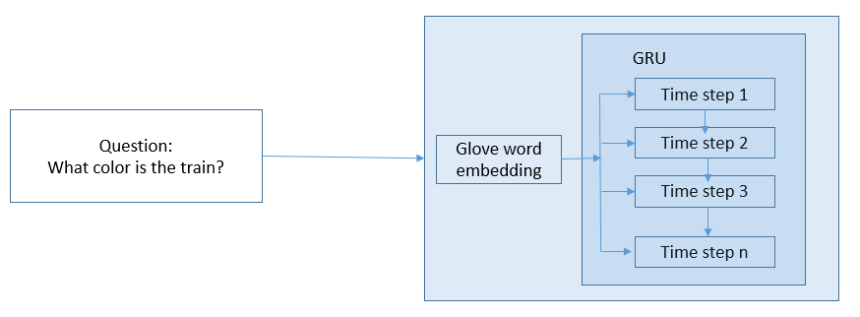
Concatenate question embedding with image features
Image features (1 X 36 X 2048)
Normalize
Concatenation
Concatenated features (36 X (2048 + 512) )
Repeat
For each of the 36 salient image regions,
image feature vector is concatenated with question embedding
Question encoding (1 X 512)

Slide 9
Top down attention
pass concatenated tensor through a non-linear and a subsequent linear layer to obtain a scalar attention weight for each of the 36 image regions.
Softmax converts the attention score into a probability value by normalizing the score over all locations.
For the question asked, top down attention
calculates weights for each image region.
then takes a weighted sum the regions by the weights.
Thus, it gives a 1 X 2048 vector, which we call attended image.
Concatenated features
Non linear layer (Gated tan h)
Input = 2048+512, Output=512
Linear
I = 512, O=1
(36 X (2048 + 512) )
(36 X 512)
(36 X 1)
Weighted sum (Top down Attention)
softmax
(1 X36 X 2048)
(36 X 1)
Attended image (1 X 2048)

Slide 10
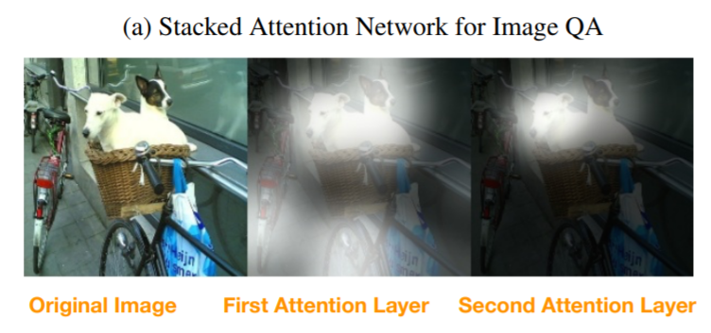
Dual top down stacked attention
For complicated questions, a single attention layer is not sufficient to identify the correct region for answer prediction. Dual stacked attention adds the attended image vector back to the question vector, and performs one more iteration of attention.
Question
what is sitting in the basket on a bicycle?
Image source, Z. Yang, X. He, J. Gao, L. Deng, and A. Smola. Stacked Attention Networks for Image Question Answering

Slide 11
Dual top down stacked attention
adds the attended image vector back to the question vector, and does one more iteration of attention.
Thus, refined question vector is used to give higher weights on the visual regions that are more relevant to the question
Concatenated features
Non linear layer (Gated tan h)
Input = 2048+512, Output=512
Linear
I = 512, O=1
+
(36 X 512)
(36 X 1)
(36 X (2048 + 512) )
Weighted sum (Top down Attention)
softmax
(1 X36 X 2048)
Attended image (1 X 2048)
(36 X 1)
Non linear layer (Gated tan h)
Input = 2048, Output=512

Slide 12
Multimodal fusion, joint embedding
Multimodal fusion projects question & image vectors on to a joint “semantic” space
Attended Image
Non linear layer (Gated tan h)
Input = 2048 Output = 512
(1 X 2048)
(1 X 512)
Multimodal fusion
(Hadamard product)
Non linear layer (Gated tan h)
Input = 512 Output = 512
(1 X 512)
(1 X 512)
(1 X 512)

Slide 13
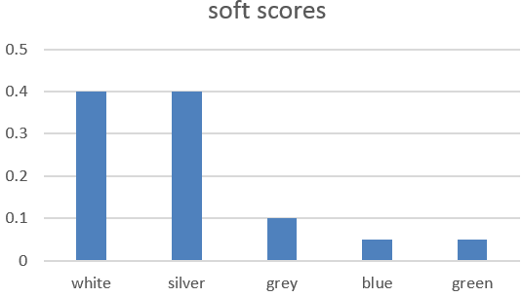
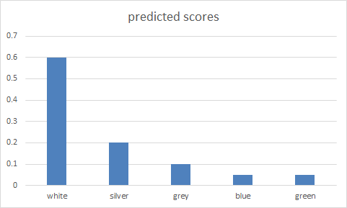
Multi-label classification & cross entropy loss
Non linear layer (Sigmoid)
multi class classifier
Input =512 ,
Output = 3129 (candidate answer classes)
Multimodal fusion
(Hadamard product)
(1 X 512)
Soft scores, Label
Predicted scores
Cross entropy loss

Slide 14
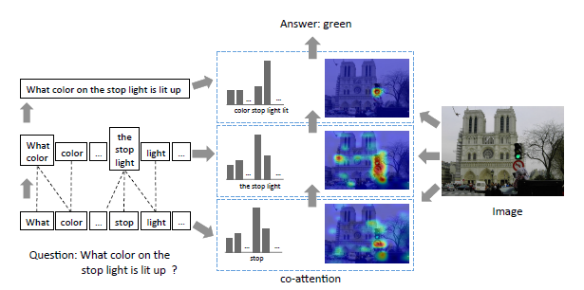
Hierarchical Question-Image Co-Attention
Sentence Level
Phase Level
Word Level

Slide 15
Hierarchical Question-Image Co-Attention
Phase Level
N gram-CNN
Max Pool
Word Level
Sentence Level
+
Concatenated features
Non linear layer (Gated tan h)
Input = 2048+512, Output=512
Linear
I = 512, O=1
(36 X (2048 + 512) )
(36 X 512)
(36 X 1)
Weighted sum (Top down Attention)
softmax
(1 X36 X 2048)
(36 X 1)
Attended image (1 X 2048)

Slide 16
One glimpse VS stacked attention Vs Hierarchical Co- Attention
Trained on Google colab for preliminary model comparison
Training data set:
11,983 images
64,604 questions
Test data set:
5,762 images
30,933 questions
Complete results , with model trained on Google cloud available in report.
 | Attention Mechanism | Test Accuracy
 | Bottom Up top Down- One Glimpse | 39
 | Dual top down stacked attention | 39
 | Hierarchical Question-Image Co-Attention | 41

Slide 17
 | Attention Mechanism | Test Accuracy
 | Bottom Up top Down- One Glimpse | 39
 | Dual top down stacked attention | 39
 | Hierarchical Question-Image Co-Attention | 41

